Slide 1


AFSCME Local 2829 Welcomes YOU!
An Intro to Your Union. www.afscme2829.org

Slide 2

Who is
AFSCME is one of the largest unions in the United States. Unions are known for protecting members in the workplace and secure worker’s rights. Full paying members are important to the strength and integrity of the union as a whole. Through the union, workers have the ability to negotiate from that position of strength with the employer! Unions serve an important role making sure that management acts fairly and treats its workers with respect.
We encourage you to join and become a full active member today!
American Federation of State, County and Municipal Employees

Slide 3
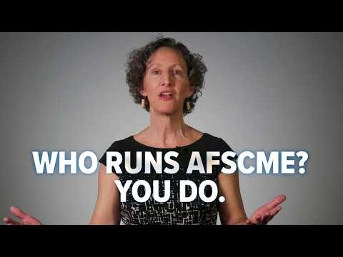
Introductions
Your name
Your job description/unit/division
Have you ever been in a union?
Home life – Children? Pets? Things you like to do for fun?
Any work concerns?

Slide 4
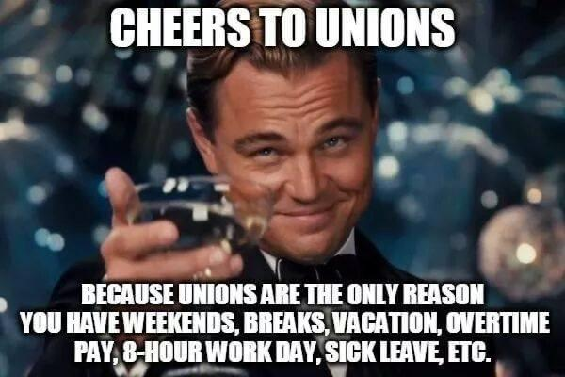
Council 5 - Local 2829
Your AFSCME Council and Local

Slide 5
Background on Council 5 and Local 2829
Main council of all Minnesota AFSCME Locals that represents people who work for state and local governments, school boards, health care providers and non-profit organizations.
Council Field Rep: Bryce Wickstrom
Executive Director: Bart Andersen
Main Site: www.afscmemn.org
Member Link: https://members.afscmemn.org/Login.aspx
Local 2829 is comprised of about 60 different site locations with a variety of agencies and departments throughout the entire State of Minnesota. MPCA, DNR, Department of Human Services, Department of Health, Tourism, US Military, and the Attorney Generals Office to name just a few. The wide variety of departments is what makes us “Amalgamated” and one of the largest locals in the State of Minnesota today. Visit our Local website at www.afscme2829.org
Local Officers:
President: Curtis Seelen (MN Pollution Control)
Vice President: Rachel Parlin (MN Pollution Control)
Secretary: Julie Ann Jeppesen (Attorney Generals Office)
Treasurer: Eric Mattson (MN Housing and Finance)
Chief Steward: Curtis Seelen
Executive Board: Manisha Roberts, Judy Sigal, Sherry Mottonen, 2 vacancies

Slide 6
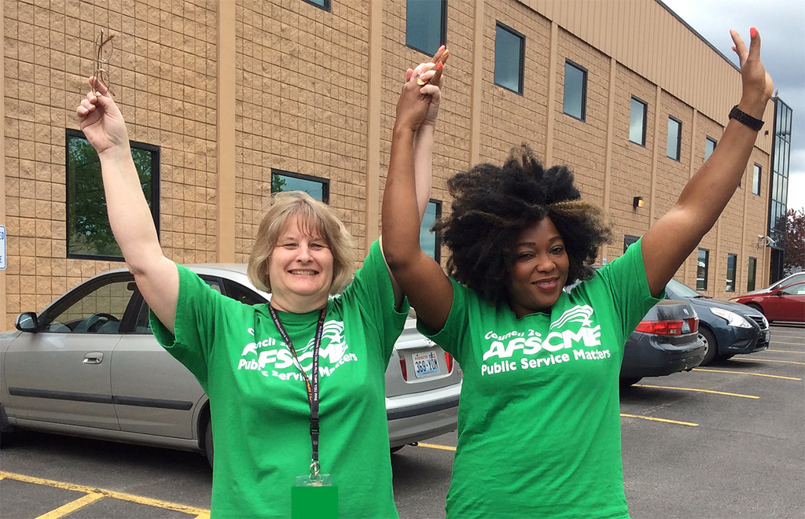
Being in has many advantages…
This Photo by Unknown Author is licensed under CC BY-NC

Slide 7
What does for their members
Special Member Benefits
Monthly Membership Meetings
The AFSCME Advantage Program and other special offers provide many great benefits by being a full paying union member:
Scholarships
AT&T Wireless discounts.
Auto Insurance discounts.
Sporting event tickets and theme park ticket discounts.
Travel discounts.
Union credit cards with great rates.
Council Newsletters
And More!
Local 2829 conducts monthly membership meetings on the fourth Wednesday of every month via zoom and/or in person at 5:30pm. Discussion includes a wide array of membership topics. If you would like more information, or would like to attend, you can contact any of our Local officers!
Get Active
Our jobs are highly political. We have events throughout the year, such as Day on the Hill in March, where AFSCME gathers at the Capitol and together, with people you live near by, speak to legislators directly on work-related issues that matter to public service workers! Members are compensated for the day off.

Slide 8

State Contract
Our Agency is covered under units 6 and 7 under the State Contract.

Slide 9
What does for their members
Fair Contracts
Member’s Rights
Contracts are renewed every biennium on the Fiscal Year (example: July 1, 2023-June 30, 2025). Only full paying members can vote on contracts to pass or fail. Contracts negotiate important worker’s:
Pay raises.
Benefits such as vacation and sick time.
Good health insurance premiums/copays/etc.
Pension
Seniority
Worker health and safety.
Job Training.
And More!
AFSCME protects all members in the workplace! We act on:
Contract violations by filing grievances on your behalf.
Being a mediator between employer and employee.
You are NOT alone! If you ever feel like you need advice, contact me!

Slide 10
When it’s time to contact a steward…
When a boss calls you into your office and they answer yes to it leading to disciplinary action. (You have every right to ask this question when a meeting is set)
When a boss or coworker threatens you.
This is the top reason to consult with a steward. If a meeting will lead to disciplinary action, you have the right for representation. Contact me right away!! We will help coach you through as to not implicate yourself in any way, even if you feel like you deserve the punishment! We are your legal representatives!
It may be time for mediation.
We can call meetings with the employee and the supervisor or other upper management depending on the situation

Slide 11






Recap
Who is AFSCME Council 5 - Local 2829?
Fair Contracts
Workers’ Rights
Your union!
Full members can vote on whether to accept a contract or strike! Together we secure wages, health insurance, pension and workplace safety!
We will be your voice if the employer breaks contract language!
AFSCME Advantage
Join Today!
Feel Secure
Full paying members enjoy members-only benefits!
Union membership provides a voice for all workers in the workplace!
We have your back!

Slide 12
THANK YOU!
Join Today!
Click here to join us
Phone: 651-450-4990
Email: council5@afscmemn.org
Local Website: www.afscme2829.org
Welcome to AFSCME Local 2829!

